Slide 1

 | BMS INSTITUTE OF TECHNOLOGY & MANAGEMENT, YELAHANKA, BANGALORE. Department of Artificial Intelligence and Machine Learning
“Quantum Fit”
AANISH P-1BY22AI002
ADITYA RAJ-1BY22AI008
MS PRAJWAL-1BY22AI051
MAYUR-1BY22AI054
Under the guidance of:
dr. KANTHARAJU V
ASSISTANT PROFESSOR
Department of ise
BMSIT&M
2023-24

Slide 2
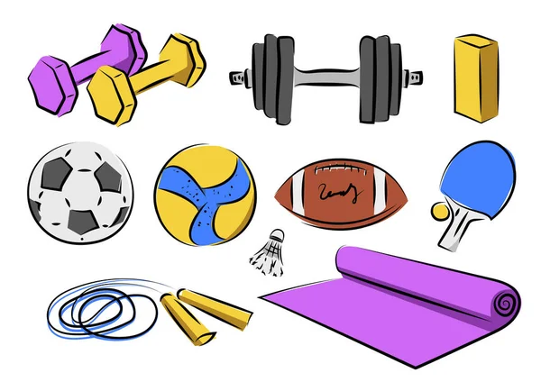
CONTENT
Introduction
Literature Survey
Limitations of Existing Systems
Research Gap and Research Challenges
Problem Statement
Objective
Proposed Methodology
Expected output
Subject Mapping (write which subjects you can Map)
References

Slide 3

INTRODUCTION
Overview of Quantum Fit Project:
Quantum Fit is a revolutionary web-based fitness platform designed to cater to individual health and well-being.
It serves as a personalized fitness hub, leveraging user-provided data to create tailored diet plans and training routines.
Importance of Personalized Fitness in Contemporary Society:
In today's fast-paced world, generic fitness solutions may not address the diverse and unique needs of individuals.
Quantum Fit acknowledges the significance of personalized fitness, recognizing that one-size-fits-all approaches often fall short in delivering optimal health outcomes.
Motivation Behind Developing Quantum Fit:
The motivation behind Quantum Fit stems from a commitment to empowering individuals on their fitness journeys.
By amalgamating user-provided data seamlessly, Quantum Fit aims to bridge the gap between generic fitness solutions and the need for tailored, effective health plans.
The project envisions a future where everyone can access personalized fitness guidance, ultimately enhancing their overall well-being.

Slide 4
LITERATURE SURVEY
SN. | AUTHORS | TITLE | ABSTRACT
1 | Cameron Lister, Joshua H West, Ben Cannon Tyler Sax & David Brodegard | Just a Fad? Gamification in Health and Fitness Apps | A 2014 study on 132 health apps found widespread gamification but lacked adherence to guidelines. Integrating behavioral theory is crucial for enhancing health app efficacy, showcasing potential in the evolving mobile health landscape.
2 | Adrià Muntaner-Mas, Antonio Martinez-Nicolas, Carl J. Lavie, Steven N. Blair, Robert Ross, Ross Arena & Francisco B. Ortega | A Systematic Review of Fitness Apps and Their Potential Clinical and Sports Utility for Objective and Remote Assessment of Cardiorespiratory Fitness | A review of cardiorespiratory fitness (CRF) apps for health and sports reveals limited testing and varying quality. SA-6MWTapp and InterWalk show promise, but overall, further research and app improvement are emphasized.
3 | Yali Liu & Maria Avello | Status of the research in fitness apps: A bibliometric analysis | The first bibliometric study on fitness application research (2011-2019) analyzed 481 records, revealing early-stage impact in medicine, computer science, and health sciences. Dominated by the U.S., the research notes fragmented contributions but anticipates substantial progress in future scientific studies on fitness applications.

Slide 5

Limitations of Existing Systems
Inadequate Health Professional Involvement:
Some fitness apps may not have sufficient involvement from healthcare professionals or certified fitness experts. This can limit the accuracy of advice and recommendations provided within the app.
Motivational Challenges:
Sustaining user motivation over the long term is a common challenge. Some apps may lack effective strategies for keeping users engaged and motivated, resulting in decreased usage over time.
Accuracy of Tracking:
Many fitness apps rely on sensors in smartphones or wearable devices to track physical activity. However, the accuracy of these measurements can be questionable, leading to discrepancies in the recorded data.
Privacy Concerns:
The collection of sensitive health and fitness data raises privacy concerns. Users may be hesitant to share detailed personal information, leading to challenges in obtaining accurate and comprehensive health profiles.
Limited Social Interaction:
While some fitness apps include social features, others may lack robust community-building features. A sense of community and social support is crucial for long-term engagement and motivation.

Slide 6

Research Gap and Research Challenges
Data Privacy and Security:
Protecting user health data in Quantum Fit is crucial. Employ robust encryption, secure storage, and comply with data protection regulations to build user trust and ensure privacy.
User Engagement and Adherence:
Sustaining user interest is vital. Quantum Fit incorporates gamification, social features, and feedback loops to enhance engagement, making personalized fitness plans more appealing and effective.
Continuous Improvement:
Quantum Fit commits to ongoing enhancement. Regularly gathering and analyzing user feedback, the platform adapts, evolves, and introduces updates to ensure it remains effective and user-centric.

Slide 7

PROBLEM STATEMENT
Empowering Users Through Personalization:
Quantum Fit aims to empower users by providing personalized fitness solutions based on individual health data.
The project addresses the identified problem, offering tailored diet plans and workout routines to enhance user engagement and satisfaction.
Addressing Mental and Physical Health Challenges:
Explored the psychological impact of ineffective fitness plans on users, including demotivation and feelings of failure.
Demonstrated how Quantum Fit goes beyond physical health, considering the mental well-being of users by providing achievable and personalized goals.
Adapting to Modern Lifestyles:
Generic fitness plans often do not align with the dynamic lifestyles of individuals, resulting in low adherence.
Quantum Fit adapts to users' routines, making it more feasible for them to integrate personalized fitness into their daily lives, increasing long-term adherence.

Slide 8

OBJECTIVE
Clear Statement of Quantum Fit Project Objectives:
Define the primary objectives of Quantum Fit, aiming to revolutionize fitness experiences by providing personalized diet plans and workout routines.
Addressing Mental and Physical Health Challenges:
Achieve a minimum of 90% accuracy in the analysis of user health data for generating personalized diet plans.
Educational Component:
Include an educational component within the platform to inform users about the rationale behind personalized recommendations, fostering a deeper understanding of their health and fitness journey
Feedback System:
Establish a feedback loop to continually refine algorithms and improve the accuracy of personalized recommendations.

Slide 9


Proposed Methodology
User Data Collection:
Streamlined input for weight, height, and health reports.
Data Analysis and Processing:
Understand individual characteristics and needs.
Personalized Diet Plan:
Utilize nutrition algorithm for tailored diet plans.
Training Routine:
Formulate personalized workout routines with varied
options.
Risk Assessment:
Identify potential exercise risks.
Provide cautionary information for safety.
Health Professional Collaboration:
Engage professionals to validate data analysis

Slide 10

EXPECTED OUTPUT
Workouts and Training Plans:
Based on user data and preferences, your website could offer personalized workout plans, nutritional advice, or motivational content.
Nutritional Advice:
Based on user data and preferences, your website could offer personalized workout plans, nutritional advice, or motivational content.
Exercise Tutorials:
Based on user data and preferences, your website could offer personalized workout plans, nutritional advice, or motivational content.
Fitness Articles and Blog Posts:
Based on user data and preferences, your website could offer personalized workout plans, nutritional advice, or motivational content.
Personalized recommendations:
Based on user data and preferences, your website could offer personalized workout plans, nutritional advice, or motivational content.

Slide 11

SUBJECT MAPPING
HTML | CSS | JavaScript | Python

Slide 12
References
[1.]Lister, C., West, J. H., Cannon, B., Sax, T., & Brodegard, D. (2014). "Just a Fad? Gamification in Health and Fitness Apps.“
[2.]Muntaner-Mas, A., Martinez-Nicolas, A., Lavie, C. J., Blair, S. N., Ross, R., Arena, R., & Ortega, F. B. (Year not provided). "A Systematic Review of Fitness Apps and Their Potential Clinical and Sports Utility for Objective and Remote Assessment of Cardiorespiratory Fitness.“
[3.]Liu, Y., & Avello, M. (Year not provided). "Status of the research in fitness apps: A bibliometric analysis.“
[4.]West, J. H., Hall, P. C., Hanson, C. L., Barnes, M. D., Giraud-Carrier, C., & Barrett, J. (2011). "There's an App for That: Content Analysis of Paid Health and Fitness Apps.“
[5.]Lee, H. E., & Cho, J. (Year not provided). "What Motivates Users to Continue Using Diet and Fitness Apps? Application of the Uses and Gratifications Approach."

Slide 13
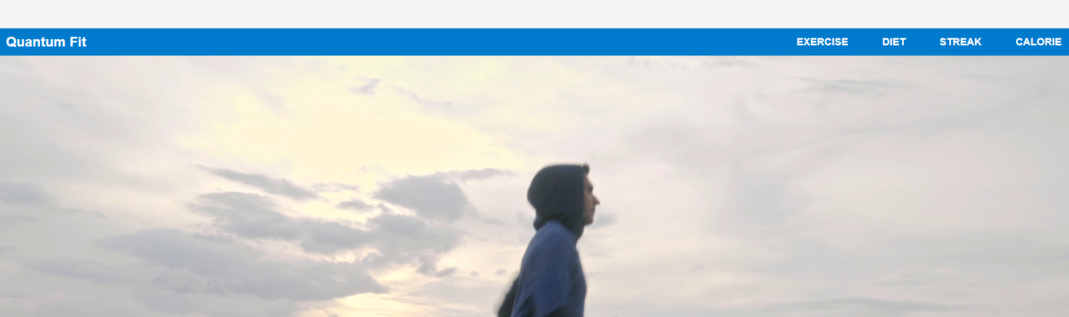
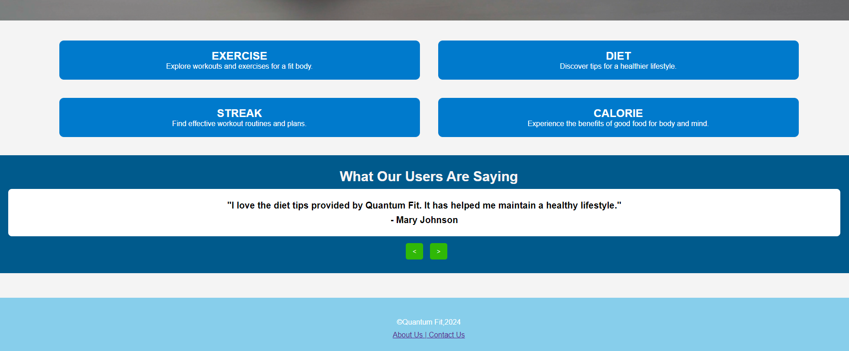
Results

Slide 14
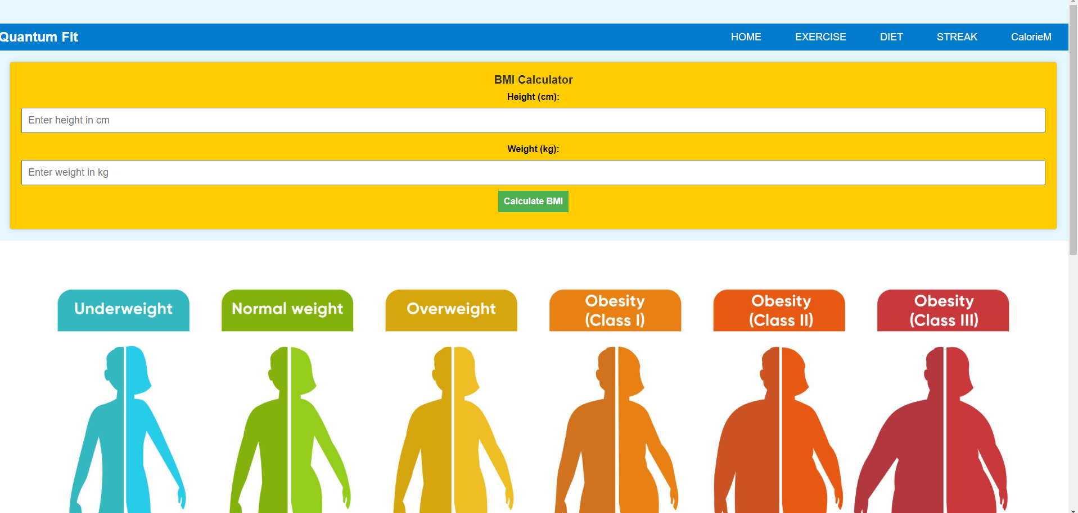
Results

Slide 15

Results

Slide 16
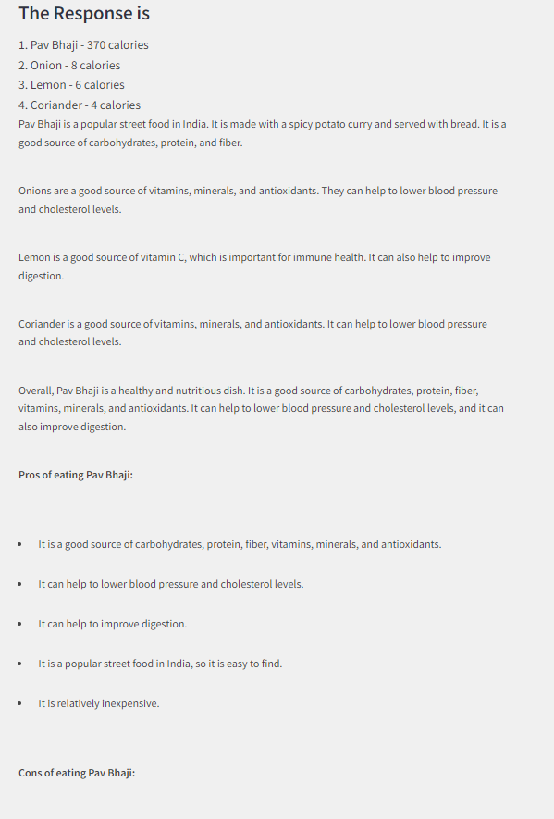

Results

Slide 17
THE END

